Slide 1
Introduction to
New IEMG Website
Presented by:
New Brunswick Department of Justice & Public Safety,
New Brunswick Emergency Measures Organization (NBEMO)
18 November 2021

Slide 2
Overview
The purpose of rebuilding the IEMG website was to provide much needed updates to the information on the site as well as how it is accessed.
The new site features easy to follow links, keeping most current information while archiving the old information (easily accessible), and renewed graphics for visual interest. All of the information on the current page has been migrated over to the new page.

Slide 3
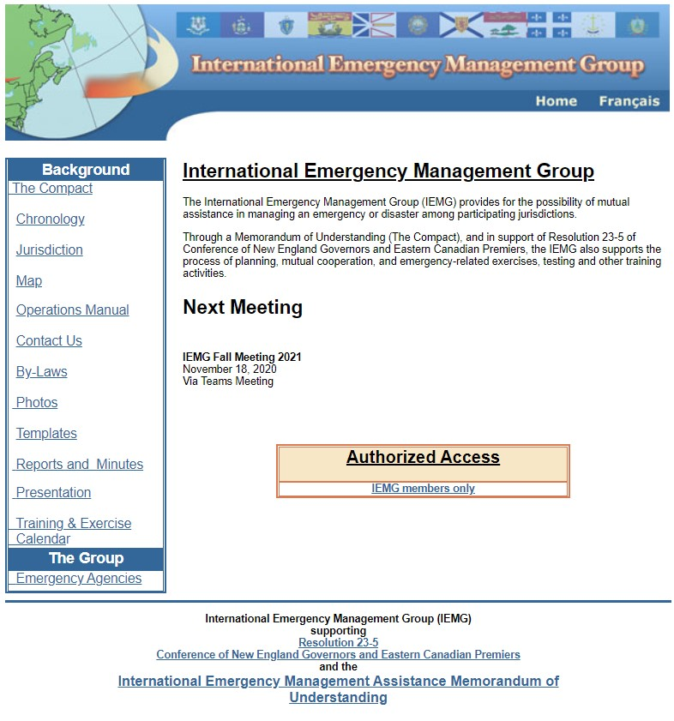
Current Website: Homepage
1
7
This is the current website homepage. It features a banner at the top (1), information on IEMG (2, 3), a list of the searchable content (4), information on the next meeting (5), an “authorized access” link (6), and a button for the French page (7) next to the “home” button.
4
2
5
6
3

Slide 4
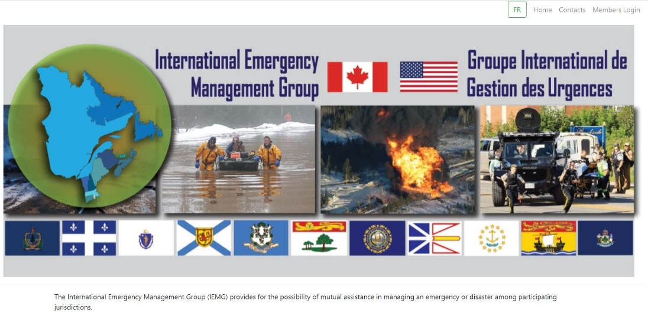
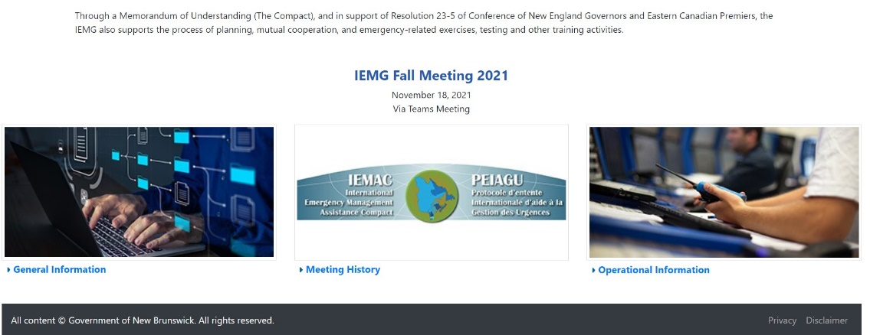
New Website: Homepage
The new website homepage features these as well, in an easy to navigate manner. The refreshed banner is at the top (1), information about IEMG in the middle (2), meeting information below that (3), then three new links that will take you to General Information (4), Meeting History (5), and Operational Information (6). The secure login is at the top (7), along with “Contacts”, “Home”, and FR for French side.
7
1
2
3
4
6
5

Slide 5
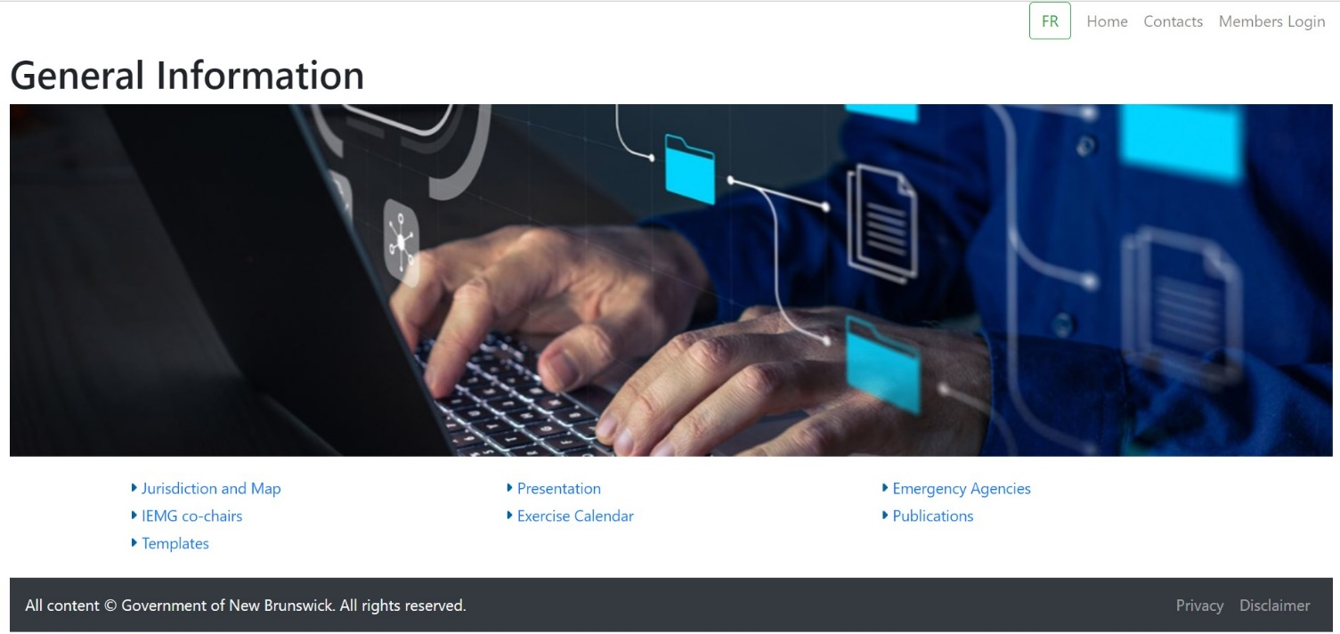
New Website: General Information
Under General Information, you will find links to:
Jurisdiction & Map
IEMG Co-Chairs
Templates
Presentations
Exercise Calendar
Emergency Agencies
Publications

Slide 6
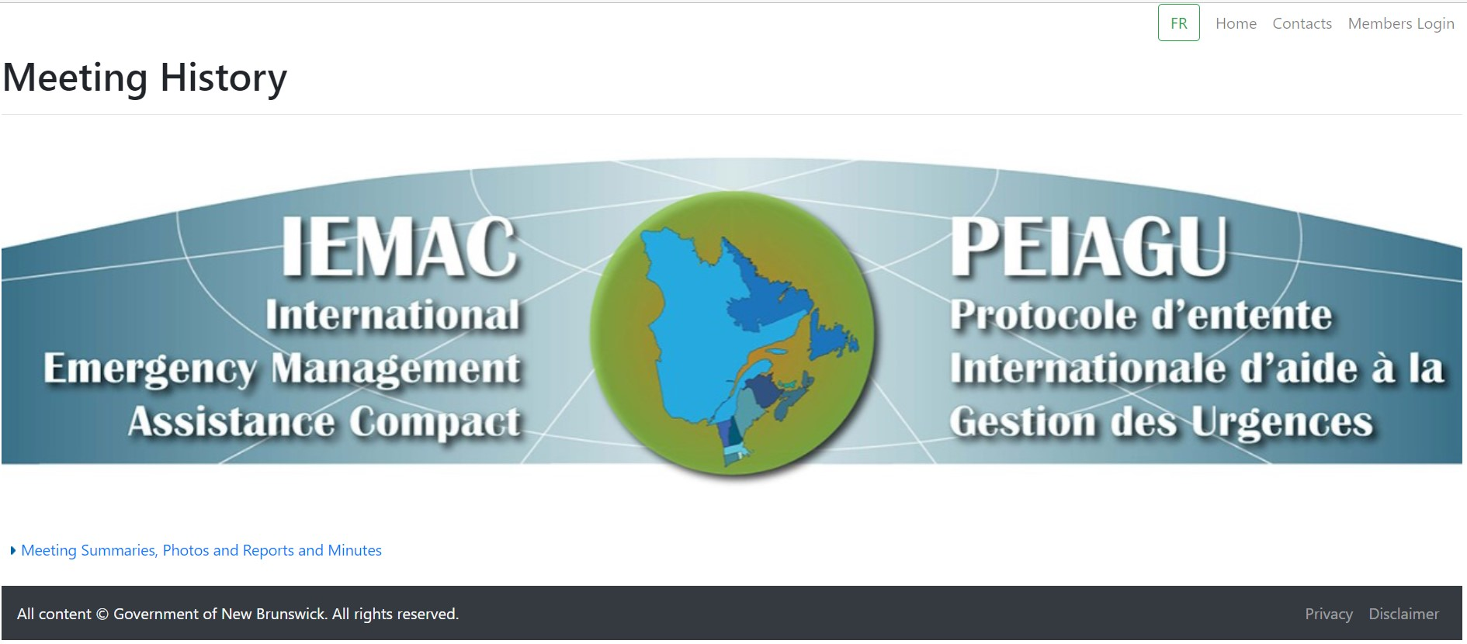
New Website: Meeting History
Under Meeting History, there is a link that will bring you to meeting summaries, meeting photos, reports, and minutes.

Slide 7
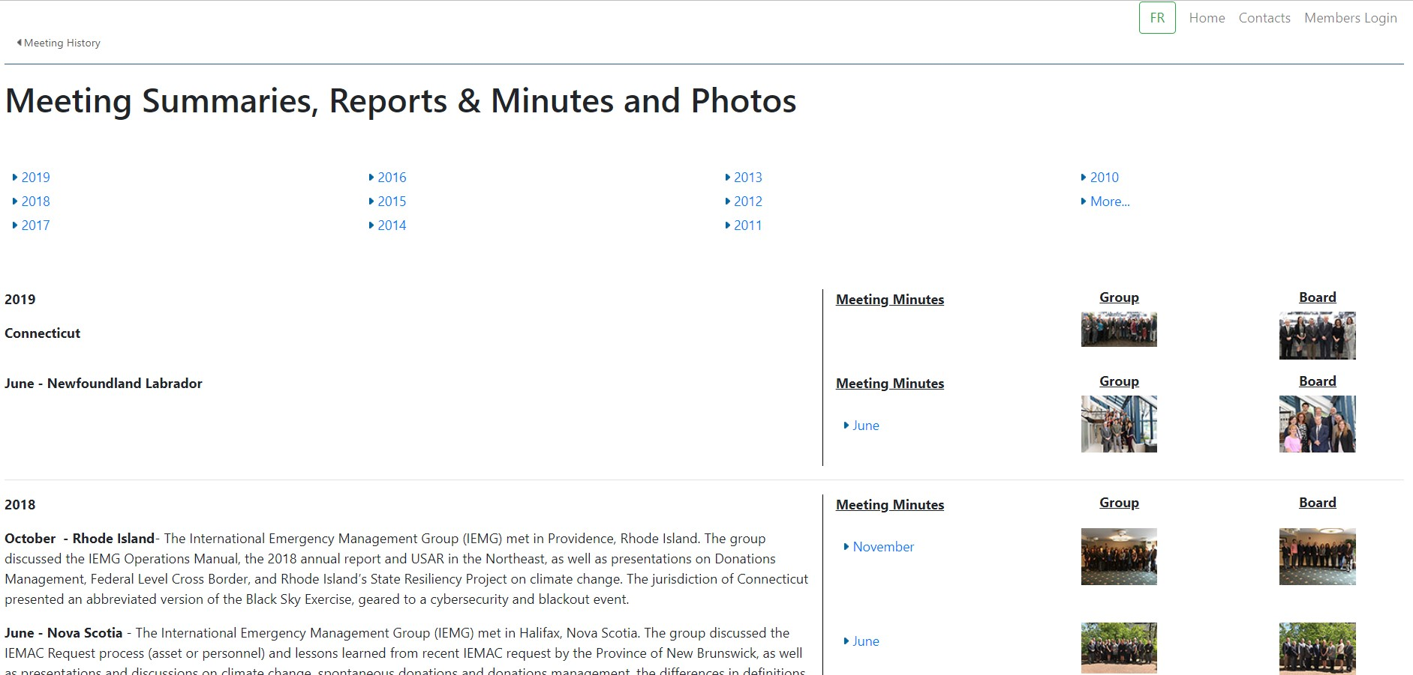
New Website: Meeting History

Slide 8
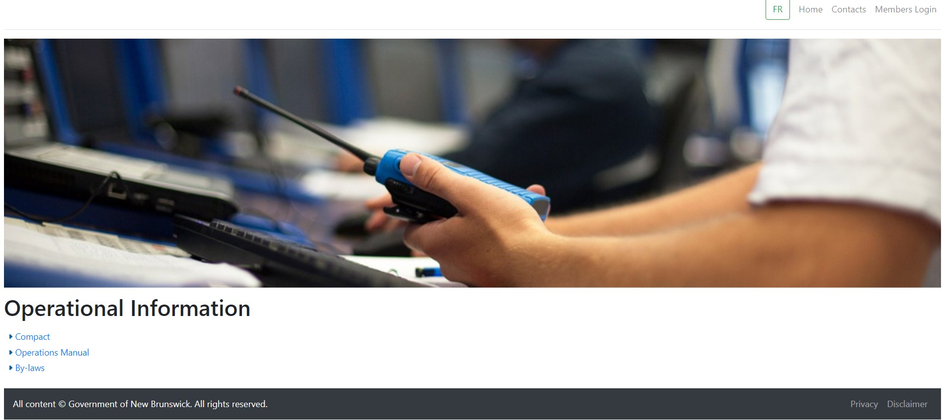
New Website: Operational Information
Here you will find information on the legal/formal side of the website, such as the Compact, Operations Manual, and By-Laws.

Slide 9
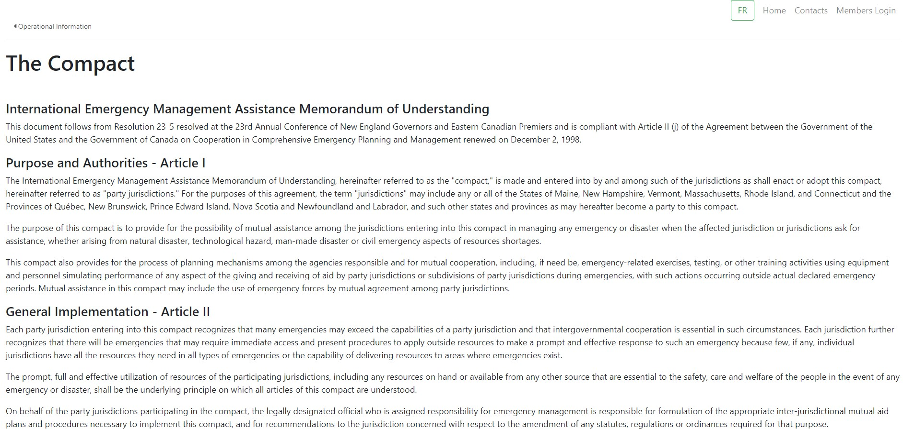
New Website: Operational Information

Slide 10
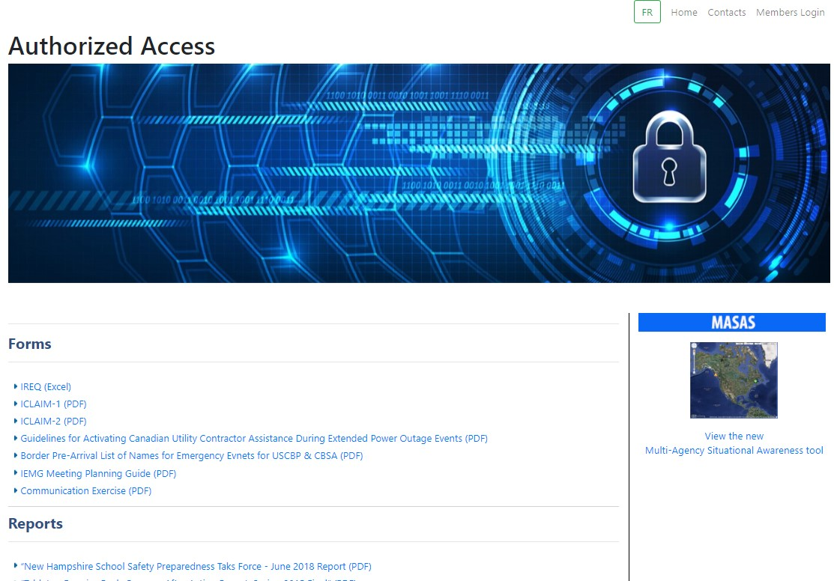
New Website: Members Login
The Member Login section will use the same username and password as the current site –
Username: iemgweb1
Password: giguweb2
It features:
Forms
Reports
Presentations
Contact Sheets

Slide 11



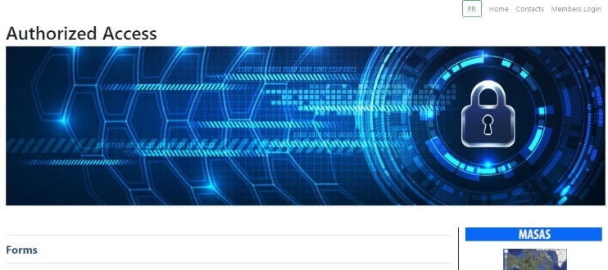
Conclusion
While the content primarily stays the same, the new website provides ease of access to the information and a fresh, new “face” of the IEMG with its better navigation and vibrant graphics. Going forward we will actively keep the website current and appealing to members and visitors.

Slide 12
Questions?

